Slide 1

Objective
This work is oriented to develop an application based on reinforcement learning algorithm. This technique belongs to a wider field of research that is Machine Learning. It represents a branch of artificial intelligence oriented to design systems capable of learning, accomplishing tasks, making predictions based on the acquisition of large quantity of data. Intelligent systems, in this way, end up acquiring experience regarding how to sort off the problem without having explicit instructions from the designers

Slide 2
Among all the techniques in the artificial intelligence field, it is possible to recognize two main categories:
Supervised Learning: in supervised learning the system is learning from a training set of labelled examples provided by an external supervisor. Each example is a description of a situation together with a specification, the label, of the correct action the system should take to that situation, which is often to identify a category to which the situation belongs. The object is to extrapolate, or generalize, its responses so that it acts correctly in situations not present in the training set.
Unsupervised Learning: it consists of finding structures hidden in collections of data. Based on these structures, the system should be able to classify the input data.
Both of these categories do not have an explicit interaction between the intelligent system and the environment. Since Reinforcement Learning is strongly affected by the information conveyed from the external environment in response to each action the agent makes, we can classify this technique in the middle between supervised and unsupervised learning.

Slide 3
What is an Agent?
An intelligent agent is a computer system capable of flexible autonomous action in some environment. It can be seen as an upgrade of the object-oriented programming paradigm. Indeed, a program is considered intelligent if the following properties hold:
Reactivity: a reactive system maintains an ongoing interaction with its environment. It is capable to respond to changes that occur in the environment (in time for the response to be useful).
Proactiveness: is the capability of generating actions to attempt to achieve the goal. Thus, is the ability to take the initiative.
Social: sociality characterizes multi-agent systems. Sometimes, in order to achieve the goal it is convenient to define a net of communication where each agent shares information. Thus, intelligent agent should be able to collaborate
Generally, at each time instant an agent must choose among the set of all the possible actions the best action to perform according to the information obtained from the environment. The sequence of actions should accomplish the task.

Slide 4
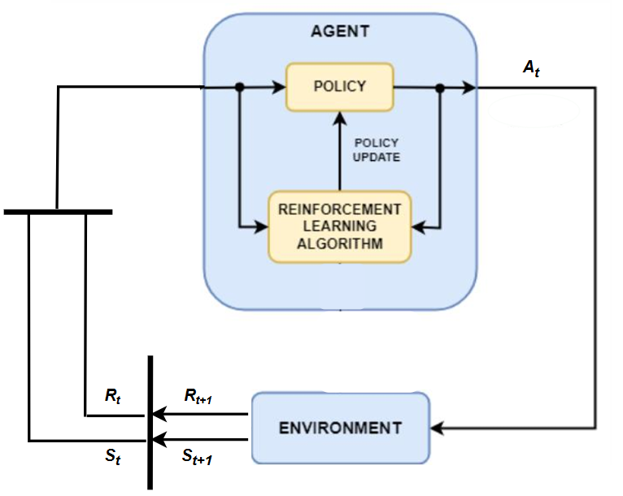
Reinforcement Learning
Reinforcement learning is based on a continuous interaction with the external environment:
Where:
S represents the observation of the environment performed at each time. It is the measurable data that the agent can observe.
R is the reward, a scalar value sent from the environment to the agent.
A is the action actuated at each time from the agent. The action can modify the state of the environment which generates as a consequence a new state and the corresponding reward that can be seen as an indicator of how good was the action performed.

Slide 5
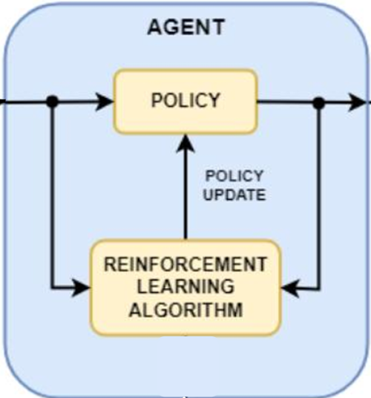
Reinforcement Learning
An agent can be defined by the relationship between two entities:
Policy: it is a mapping from the space of the observations to the space of the actions. The policy associates an action to the observation.
Algorithm: it can be seen as the ‘brain’ of the agent since based on the experience obtained from the data acquisition it updates the policy, so the behaviour of the agent.

Slide 6
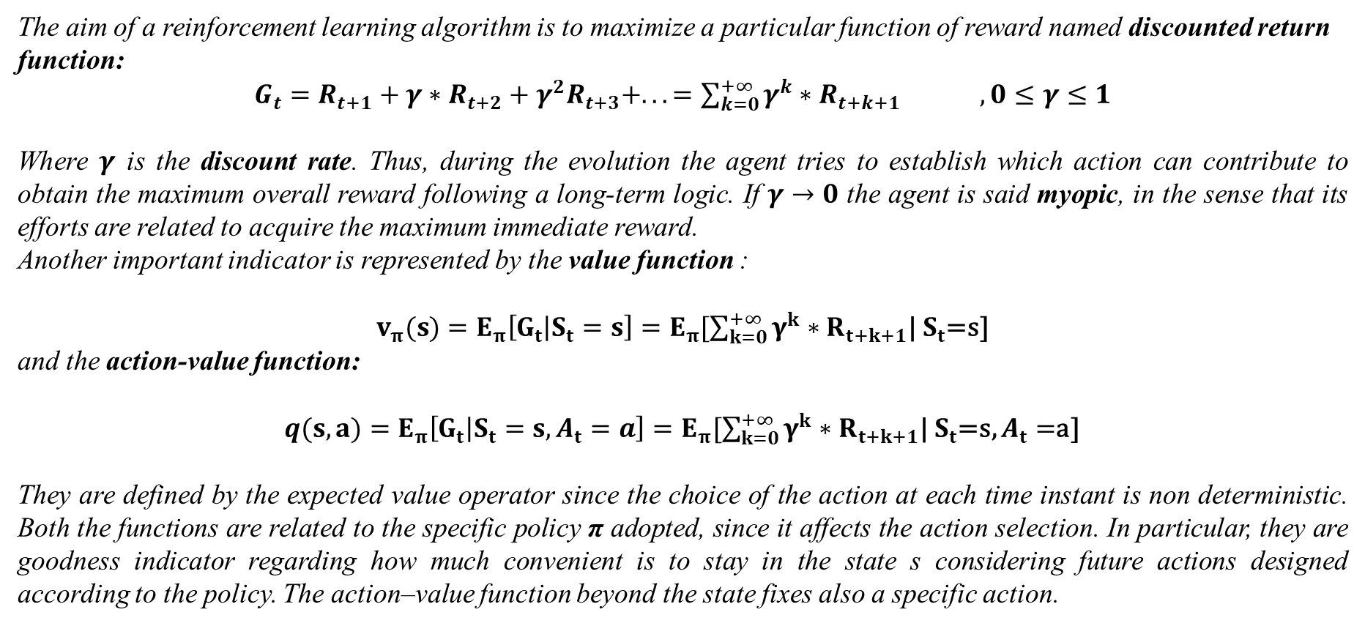
Reinforcement Learning
The aim of a reinforcement learning algorithm is to maximize a particular function of reward named discounted return function:
$G_{t}=R_{t+1}+γ∗R_{t+2}+γ^{2}R_{t+3}+. . .=\sum_{k=0}^{+∞}{γ^{k}}∗R_{t+k+1} , 0≤γ≤1$
Where $γ$ is the discount rate. Thus, during the evolution the agent tries to establish which action can contribute to obtain the maximum overall reward following a long-term logic. If $γ→0$ the agent is said myopic, in the sense that its efforts are related to acquire the maximum immediate reward.
Another important indicator is represented by the value function :
$v_{π}(s)=E_{π}\left[G_{t} | S_{t}=s\right]=E_{π}[\sum_{k=0}^{+∞}{γ^{k}}∗R_{t+k+1}$| $S_{t}$=s]
and the action-value function:
$q(s,a)=E_{π}\left[G_{t} | S_{t}=s,A_{t}=a\right]=E_{π}[\sum_{k=0}^{+∞}{γ^{k}}∗R_{t+k+1}$| $S_{t}$=s, $A_{t}=$a]
They are defined by the expected value operator since the choice of the action at each time instant is non deterministic. Both the functions are related to the specific policy π adopted, since it affects the action selection. In particular, they are goodness indicator regarding how much convenient is to stay in the state s considering future actions designed according to the policy. The action–value function beyond the state fixes also a specific action.

Slide 7
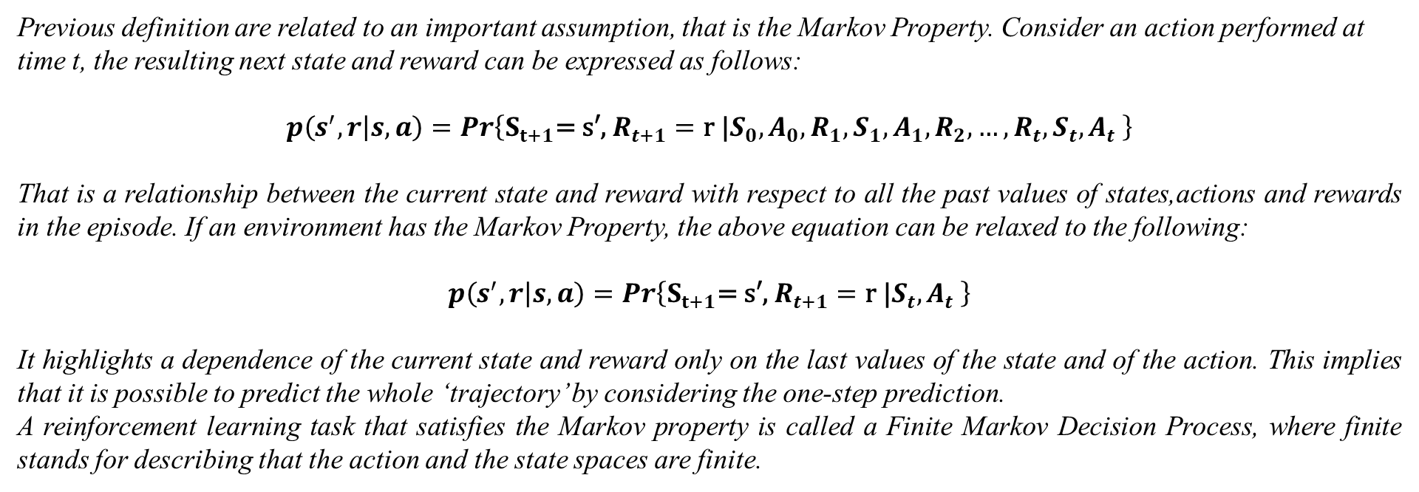
Markov Property
Previous definition are related to an important assumption, that is the Markov Property. Consider an action performed at time t, the resulting next state and reward can be expressed as follows:
$$p\left(s^{′},r | s,a\right)=Pr\left\{S_{t+1}\text{=} \text{s}\text{′}\text{, }R_{t+1}=\text{r}\text{ |}S_{0},A_{0},{R_{1},S}_{1},A_{1},R_{2},…,R_{t},S_{t},A_{t} \right\}$$
That is a relationship between the current state and reward with respect to all the past values of states,actions and rewards in the episode. If an environment has the Markov Property, the above equation can be relaxed to the following:
$$p\left(s^{′},r | s,a\right)=Pr\left\{S_{t+1}\text{=} \text{s}\text{′}\text{, }R_{t+1}=\text{r}\text{ |}S_{t},A_{t} \right\}$$
It highlights a dependence of the current state and reward only on the last values of the state and of the action. This implies that it is possible to predict the whole ‘trajectory’ by considering the one-step prediction.
A reinforcement learning task that satisfies the Markov property is called a Finite Markov Decision Process, where finite stands for describing that the action and the state spaces are finite.

Slide 8
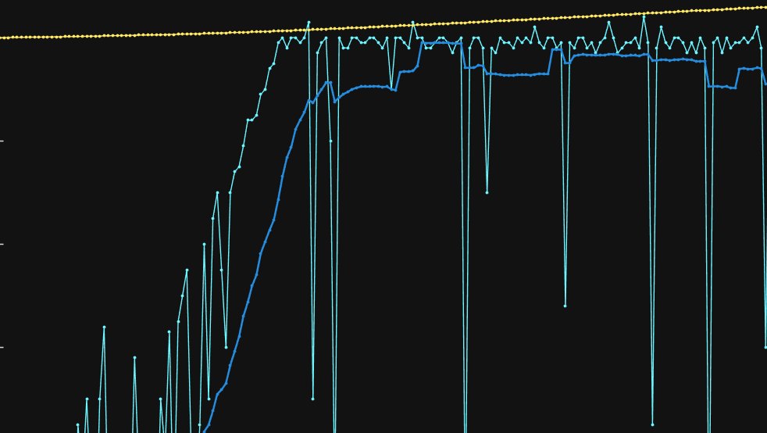
Application

Slide 9
Formulate
Problem
Create
Environment
Define
Reward
Create
Agent
Train
Agent
Validate
Agent
The application considers a well known problem in robotics that is the obstacle avoidance. Given start and goal position of a mobile robot we want to design a safe path capable of guiding the robot towards the goal avoiding static obstacles in the environment. To sort off this task, many techniques have been developed during years belonging to the so called Planning Problem. Most of them are considered optimal since are based on optimal algorithms such as: A*, Djikstra. In this application the problem is faced differently, indeed we would like obtaining a safe trajectory computed by a reinforcement learning algorithm. The main difference with respect to the planning cases is the local point of view. The solution will be the maximization of the expected reward due to each action.

Slide 10
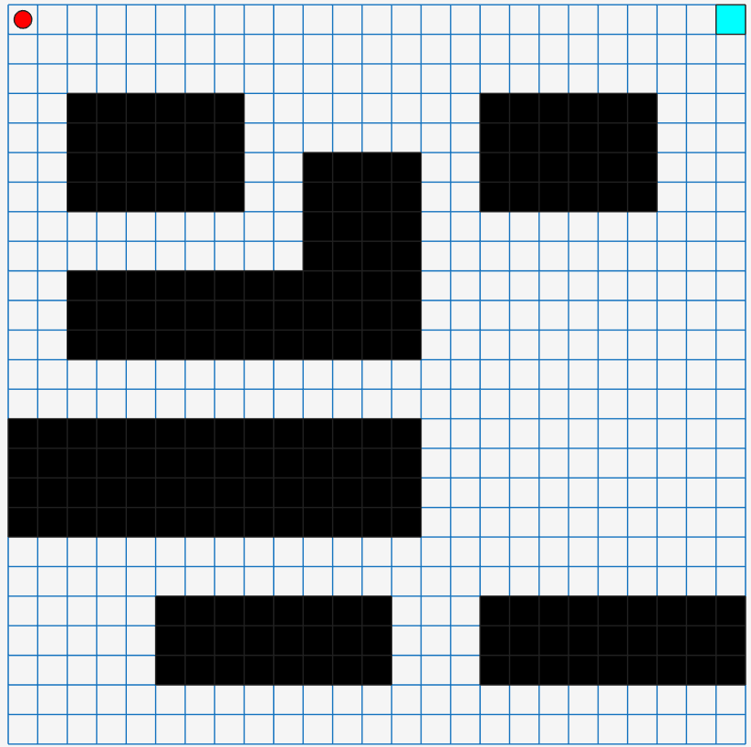
Formulate
Problem
Create
Environment
Define
Reward
Create
Agent
Train
Agent
Validate
Agent
The environment is represented by a Grid World Environment. Starting from a predefined grid world matlab model, it is possible to create a custom environment by defining custom step and reset functions. Step function is used at each step of an episode to decide the action to be performed and to obtain the corresponding reward. The reset function establishes the initial condition for each episode, it is run every time an episode ends. The environment is a 25x25 cells represented as follows:
The start is located in position (1,1).
The goal in this easy configuration is in (1,25).
Black cells represent occupied positions.

Slide 11
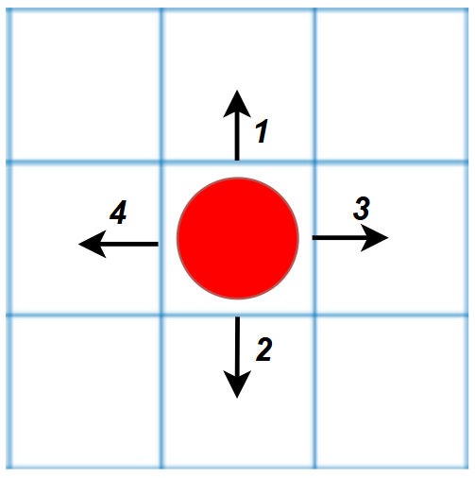
Formulate
Problem
Create
Environment
Define
Reward
Create
Agent
Train
Agent
Validate
Agent
Inside the step and reset functions is possible to manage the evolution of the agent:
Reset Function:
Step Function:
It is the core of the evolution during an episode. The agent is allowed to choose between four actions which represent movements along the cardinal directions: north,south,east,west.
The rewards associated to each move are the following:
-100 if the move causes collision with an obstacle or drives the robot outside the grid. In this case the episode ends.
+20000 if the move drives the robot on the goal position. The episode ends since the goal is reached.
+2 if the move reduces the Euclidean distance to the goal with respect to the current position.
-0.01 if the move increases the Euclidean distance to the goal with respect to the current position.
-100 if the move drives the robot to a cell already visited.
The initial state is always set to (1,1). Moreover, it contains information regarding which is the previous state and a list
of the already visited cells.

Slide 12
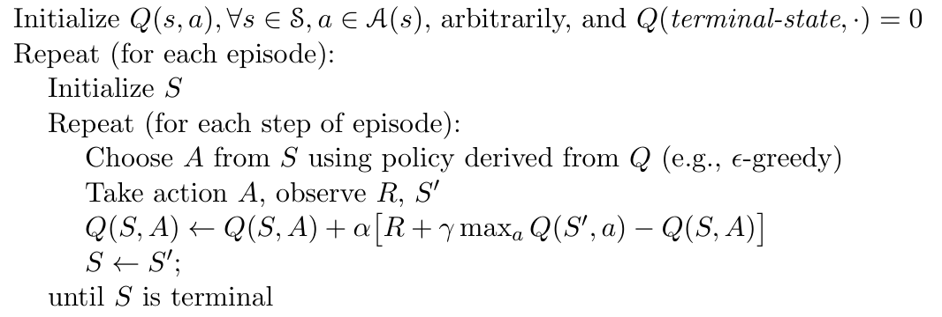
Formulate
Problem
Create
Environment
Define
Reward
Create
Agent
Train
Agent
Validate
Agent
The agent to implement is a Q-Learning Agent. Consider an action performed at time t and the resultant reward $R_{t+1}$ and next state $S_{t+1}.$ Its one-step update rule of the action-value function is the following:
$$q\left(S_{t},A_{t}\right)←q\left(S_{t},A_{t}\right)+α∗[R_{t+1}+γ∗\max_{a}(q\left(S_{t+1},a)\right)−q\left(S_{t},A_{t}\right)]$$
With $α$ small positive fraction called the step-size parameter, which influences the rate of learning.
Thanks to the above equation is possible to define the episode evolution:

Slide 13


Formulate
Problem
Create
Environment
Define
Reward
Create
Agent
Train
Agent
Validate
Agent
In the evolution here reported the action is chosen according to an ϵ-greedy policy. This means that at each call of the step function in the general state S the agent selects the action with the highest $q(s,a)$ with probability:
$$1−ε$$
The ϵ-greedy policy is useful to balance the exploitation and exploration behavior. With an high value of ϵ the agent chooses a random action with more probability giving more importance to the exploration. As a consequence it can find out new action-values which has not considered so far. On the contrary, exploitation guarantees an action choice based on the action-values in the table. This one has a number of rows equal to the number of possible states and a number of columns equal to the actions available. To create it in Matlab, first define the q-value and action-value functions:
And finally create the agent:

Slide 14

Formulate
Problem
Create
Environment
Define
Reward
Create
Agent
Train
Agent
Validate
Agent
Once the agent and the environment were created, it is possible to train the agent. During this phase it learns which are the best moves to maximize the overall reward by updating its internal action-value table. Here are reported the data regarding the value of ϵ during the training:
Initially it is set to an high value, 0.7, to promote exploration. Afterward at each call of the step function it decreases according to the value of the parameter EpsilonDecay as follows:
$ε$= $ε∗(1−\text{EpsilonDecay}$)
Epsilon is conserved between the end of an episode and the start of the next one. So, it decreases uniformly over multiple episodes until it reaches $\text{EpsilonMin}\text{=0.01}$. For what concerns the maximum number of step for episode it is set to:

Slide 15
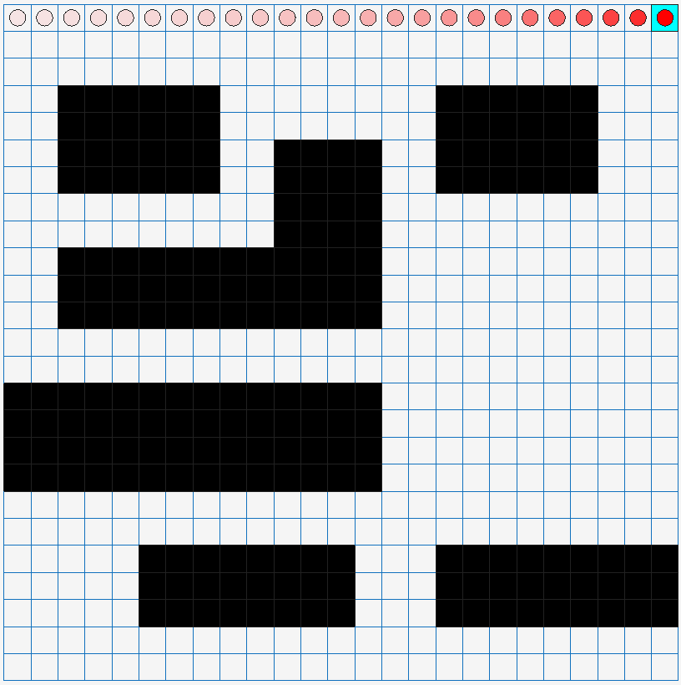
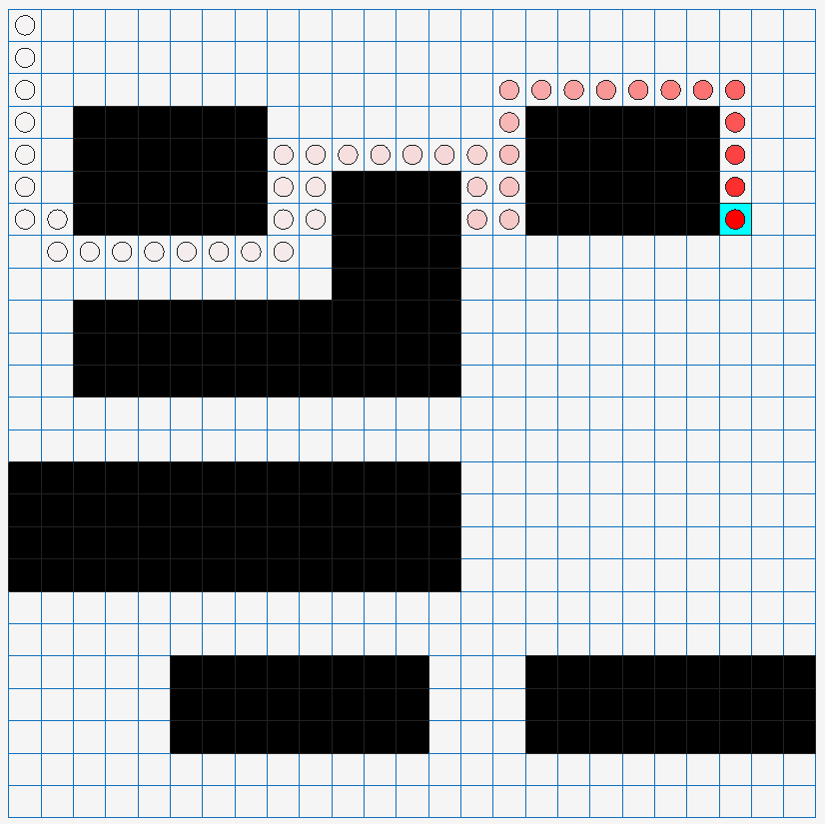
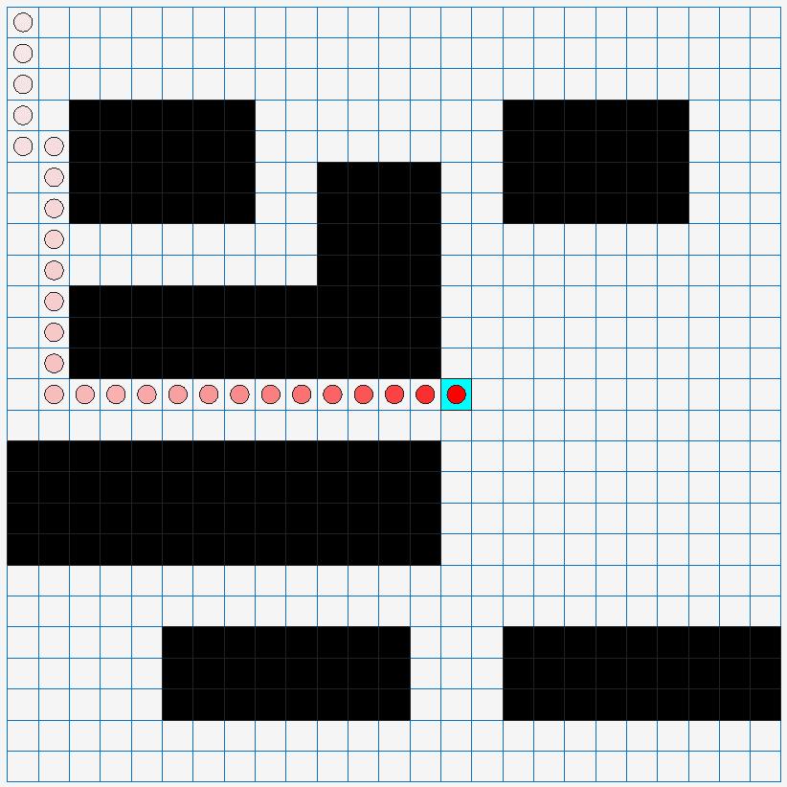
Formulate
Problem
Create
Environment
Define
Reward
Create
Agent
Train
Agent
Validate
Agent
When the agent is trained, last step regards the simulation part. Here a sequence of different configurations of the goal position and the evolution of the agent after the corresponding training:
Scenario 1: Goal in position (1,25)
Scenario 2: Goal in position (7,23)
Scenario 3: Goal in position (13,15)
Agent trained with 106 episodes
Agent trained with 145 episodes
Agent trained with 85 episodes

Slide 16
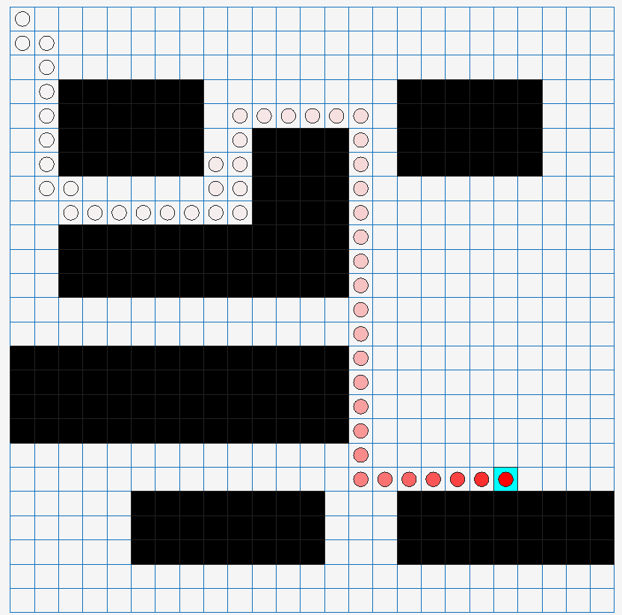
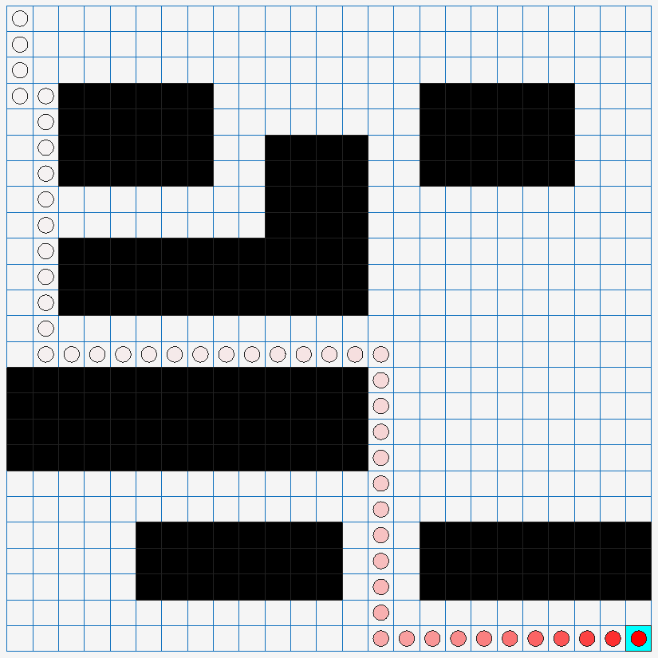
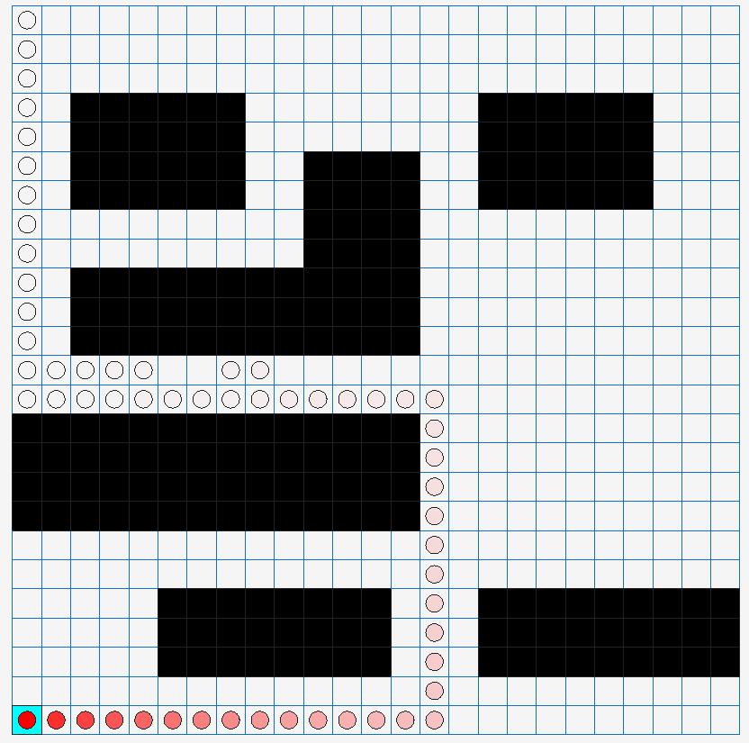
Formulate
Problem
Create
Environment
Define
Reward
Create
Agent
Train
Agent
Validate
Agent
Scenario 4: Goal in position (20,21)
Scenario 5: Goal in position (25,25)
Scenario 6: Goal in position (25,1)
Agent trained with 127 episodes
Agent trained with 118 episodes
Agent trained with 679 episodes

Slide 17
Thank You for your attention

